Slide 1

Chapter 12 Secure Multi-Party Computation Protocols
Stefan Dziembowski www.crypto.edu.pl/Dziembowski University of Warsaw

Slide 2
Plan
Definitions and motivation
Security against the threshold adversaries
overview of the results
overview of the constructions
Applications

Slide 3





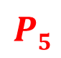
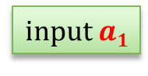
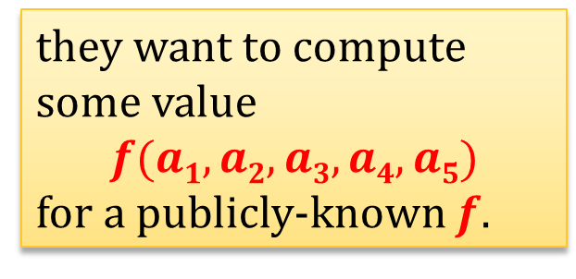
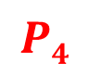
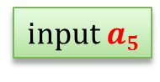
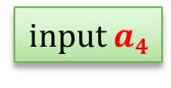
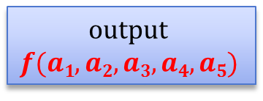
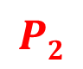
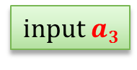

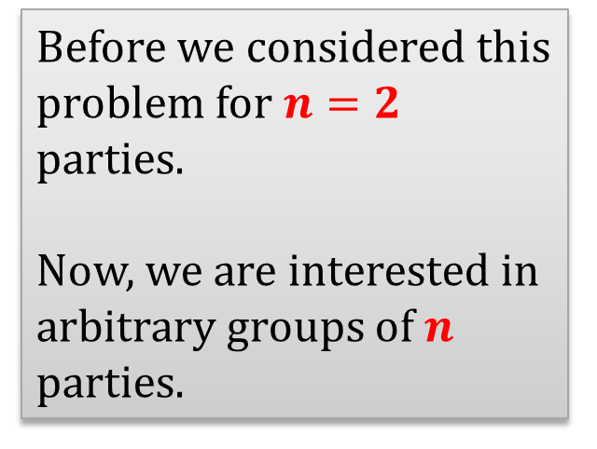
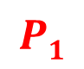

Multi-party computations (MPC)
a group of parties:
they want to compute some value
$$f(a1,a2,a3,a4,a5)$$
for a publicly-known $f$.
$$P2$$
$$P3$$
input $a2$
input $a3$
output $$f(a1,a2,a3,a4,a5)$$
Before we considered this problem for $n=2$ parties.
Now, we are interested in arbitrary groups of $n$ parties.
$$P1$$
$$P4$$
input $a1$
input $a4$
$$P5$$
input $a5$

Slide 4
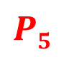
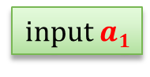
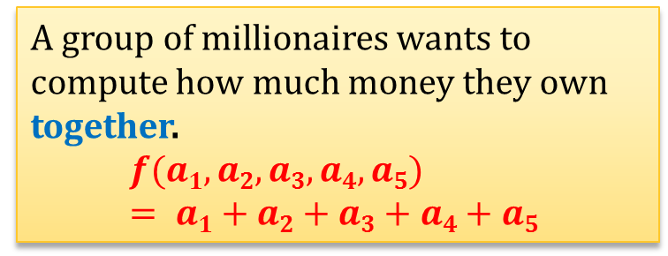


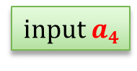

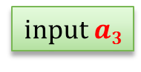
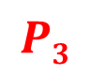
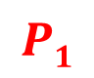

Examples
A group of millionaires wants to compute how much money they own together.
$$f(a1,a2,a3,a4,a5) = a1+a2+a3+a4+a5$$
$$P2$$
$$P3$$
input $a2$
input $a3$
$$P4$$
$$P1$$
input $a1$
$$P5$$
input $a4$
input $a5$
Another example: voting

Slide 5
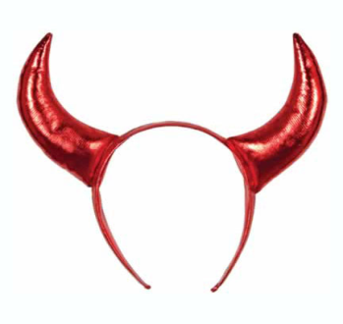

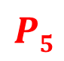



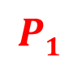
The general settings
$$P2$$
Each pair of parties is connected by a secure channel.
(assume also that the network is synchronous)
Some parties may be corrupted.
The corrupted parties may act in coalition.
$$P3$$
$$P4$$
$$P1$$
$$P5$$

Slide 6
How to model the coalitions of the corrupted parties?
We assume that there exists one adversary that can corrupt several parties.
Once a parity is corrupted the adversary “takes control over it”.
what it means depends on the settings

Slide 7
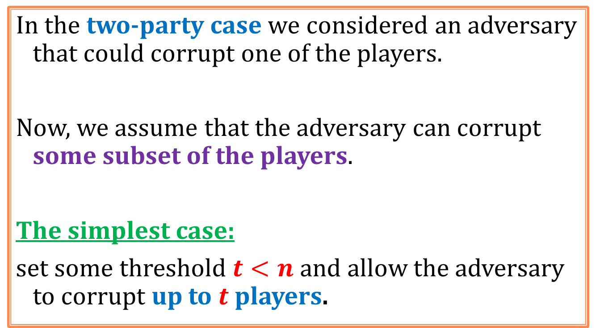
Threshold adversaries
In the two-party case we considered an adversary that could corrupt one of the players.
Now, we assume that the adversary can corrupt some subset of the players.
The simplest case:
set some threshold $t<n$and allow the adversary to corrupt up to $t$ players.

Slide 8
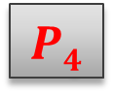




Example
$$n=5, t=2$$
$$P2$$
$$P3$$
$$P1$$
$$P4$$
$$P5$$

Slide 9
Types of adversaries
As before, the adversary can be:
computationally bounded, or
infinitely powerful,
and
passive
active
These choices are orthogonal!
 | computationally bounded | infinitely powerful
passive
active
all those choices make sense!

Slide 10
Adaptivness
In addition to it the adversary may be
adaptive – he may decide whom to corrupt during the execution of the protocol, or
non-adaptive – he has to decide whom to corrupt, before the execution starts.

Slide 11
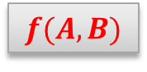
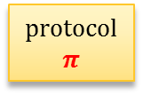
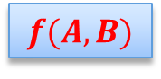

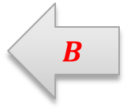
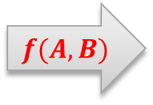

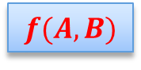

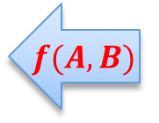



The security definition
The security definition is complicated and we do not present it here.
Main intuition: the adversary should not be able to do more damage in the “real” scenario than he can in the “ideal” scenario.
Remember the two-party case?
“real” scenario
“ideal” scenario
$$A$$
$$B$$
$$A$$
$$B$$
$$A$$
$$B$$
protocol $$π$$
$$f(A,B)$$
$$f(A,B)$$
$$f(A,B)$$
$$f(A,B)$$
$$f(A,B)$$
$$f(A,B)$$

Slide 12

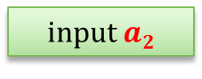
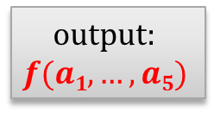
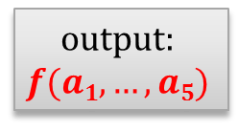
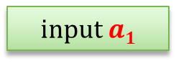
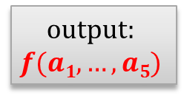
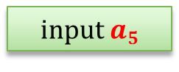
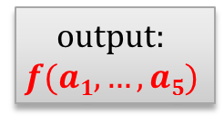
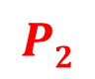

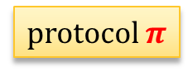

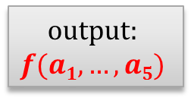

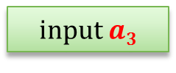
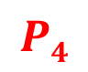
The “real scenario”
$$P2$$
$$P3$$
input $a2$
input $a3$
output:
$$f(a1,…,a5)$$
output:
$$f(a1,…,a5)$$
$$P4$$
$$P1$$
protocol $π$
input $a4$
input $a1$
$$P5$$
output:
$$f(a1,…,a5)$$
output:
$$f(a1,…,a5)$$
input $a5$
output:
$$f(a1,…,a5)$$

Slide 13


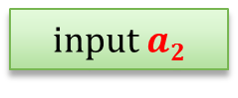
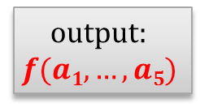
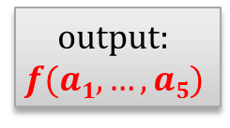

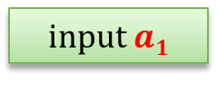
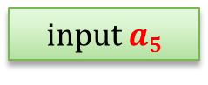
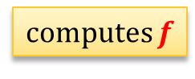


The “ideal” scenario
$$P2$$
$$P3$$
input $a2$
input $a3$
output:
$$f(a1,…,a5)$$
output:
$$f(a1,…,a5)$$
$$P4$$
$$P1$$
computes $f$
input $a4$
input $a1$
output:
$$f(a1,…,a5)$$
$$P5$$
output:
$$f(a1,…,a5)$$
input $a5$
output:
$$f(a1,…,a5)$$

Slide 14
Plan
Definitions and motivation
Security against the threshold adversaries
overview of the results
overview of the constructions
Applications

Slide 15
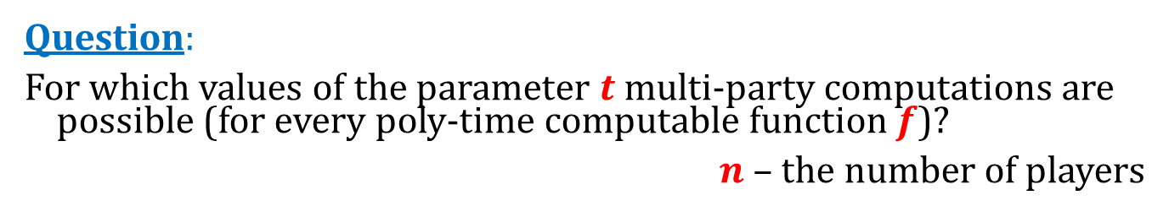
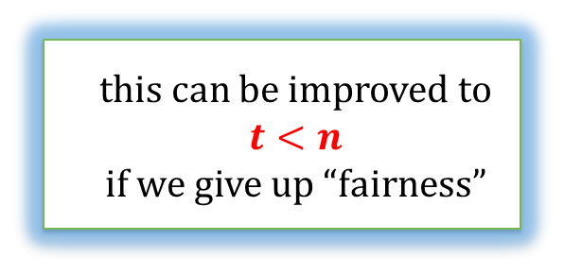


Classical results
Question:
For which values of the parameter $t$ multi-party computations are possible (for every poly-time computable function $f$)?
$n$ – the number of players
setting | adversary type | condition
computational | passive | $$t<n$$
computational | active | $$t<n/2$$
information-theoretic | passive | $$t<n/2$$
information-theoretic | active | $$t<n/3$$
this can be improved to $$t<n$$ if we give up “fairness”
(these are tight bounds)
this can be improved to $$t < n/2$$ if we add a “broadcast channel”
(Turns out that the adaptivness doesn’t matter)

Slide 16

Example of a lower bound
information-theoretic, passive: $t<n/2$
Suppose $n=6$ and $t=3$
Suppose we have a protocol for computing
$$f(a1,a2,a3,a4,a5,a6) = a1∧a2∧a3∧a4∧a5∧a6∧8$$
We show an information-theoretically secure 2-party protocol for computing
$$F\left(A,B\right)=A∧B$$
After showing this we will be done, since we know it’s impossible!

Slide 17














simulates with
$$a1 :=A$$
$$a2 ≔a3 ≔1$$
$$P1$$
$$P2$$
$$P3$$
the “internal” messages are not sent outside
input $a1$
input $a2$
input $a3$
the “external” messages are exchanged between Alice and Bob
input $a4$
input $a5$
input $a6$
$$P4$$
$$P5$$
$$P6$$
simulates with
$$a4 :=B$$
$$a5:= a6 ≔1$$

Slide 18

Correctness?
At the end of the execution of the simulated protocol Alice and Bob know
$$f\left(A,1,1,B,1,1\right)= A∧B$$
So they have computed F.

Slide 19

Why is this protocol secure?
If the adversary corrupted Alice or Bob then he “corrupted” exactly $t=3$ parties.
From the security of the MPC protocol the “new” $2$-party protocol is also secure!

Slide 20






A broadcast channel
$$P2$$
$$P3$$
m
m
m
m
m
$$m$$
$$P1$$
$$P4$$
$$P5$$
Every player receives the same message (even if the sender is malicious).

Slide 21








Byzantine Agreement
A classical problem in distributed computing [Lamport, Shostak, Pease, 1982]:
$n$ generals (connected with private channels) want to reach a consensus
there may be $t$ traitors among them
$b_{1}∈$ {attack,retreat}
$b_{2}∈$ {attack,retreat}
$b_{5}∈$ {attack,retreat}
$b_{4}∈$ {attack,retreat}
$b_{3}∈$ {attack,retreat}

Slide 22

Formally
We have the following requirements
Non-triviality: If all loyal generals have the same input bit $b$ then, the only possible decision value of the loyal generals is $b$.
Agreement: The loyal generals should agree on the decision.
Limited bureaucracy: The protocol must terminate

Slide 23

A classical result
Byzantine agreement is possible if and only if
$$t < n/3$$

Slide 24

Broadcast channel vs. byzantine agreement
If the broadcast channel is available then the byzantine agreement can be achieved as follows:
every party $Pi$ broadcasts her input $si$
the majority of the broadcasted values is the agreed value.

Slide 25
Fact
In the information-theoretic settings:
a broadcast channel can be “emulated” by a multiparty protocol.

Slide 26












Emulation
$$P2$$
$$P3$$
input $m$
output: $m$
output: $m$
$$P4$$
$$P1$$
output: $m$
$$P5$$
output: $m$
So, this is the reason, why in the information theoretic, active case we have $t<n/3$
output: $m$

Slide 27

Idea
Allow the parties to use a broadcast channel.
We get:
setting | adversary type | condition
information-theoretic | passive | $$t<n/2$$
information-theoretic | active | $$t<n/3$$
information-theoretic (with broadcast) | active | $$t<n/2$$

Slide 28
Plan
Definitions and motivation
Security against the threshold adversaries
overview of the results
overview of the constructions
Applications

Slide 29
How to construct such protocols?
The general scheme is like in the two-party case:
Represent the function as a circuit.
Let every party “share” her input with the other parties.
Evaluate the circuit gate-by-gate (maintaining the invariant that the values of the intermediary gates are shared between the parties)
Reconstruct the output.
usually: arithmetic circuit over some field

Slide 30













Arithmetic circuits (over a field F)
output gates
$$c1$$
$$c2$$
$$c3$$
$$c4$$
$$c5$$
multplication
gates
*
+
*
+
*
*
*
+
+
addition gates
*
+
input gates
$$a0$$
$$a1$$
$$a2$$
$$a3$$
$$a4$$
$$a5$$
$$a6$$
$$a7$$

Slide 31

How to share a secret?
Informally:
We want to share a secret $S$ between a group of parties, in such a way that:
any set of up to $t$ corrupted parties has no information on $S$, and
if $t+1$ parties cooperate then they can reconstruct the secret $S$.

Slide 32










$m$-out-of-$n$ secret sharing
$$m=t+1$$
dealer’s secret $S$
$$(n=5)$$
$$S1$$
$$S2$$
$$S3$$
$$S4$$
$$S5$$
Every set of at least $m$ players can reconstruct $S$.
Any set of less than $m$ players has no information about $S$.
note: this primitive assumes that the adversary is passive

Slide 33


$m$-out-of-$n$ secret sharing – more formally
Every secret sharing protocol consists of
a sharing procedure: $\left(S1,…,S_{n}\right)≔share(S)$
a reconstruction procedure: for any distinct $i1,…,i_{m}$we have $S≔reconstruct(S_{i1},…,S_{i_{m}})$
a security condition: for every $S,S$’ and every $i1,…,i_{m−1}$:
$\left(S_{i_{1}},…,S_{i_{m−1}}\right)$ and $\left(S_{i_{1}}^{′},…,S_{i_{m−1}}^{′}\right)$ are distributed identically,
where:
$\left(S1,…,S_{n}\right)≔share(S)$and $(S_{1}^{′},…,S_{n}^{′}) := share(S’)$
matching

Slide 34










Shamir’s secret sharing [1/2]
Suppose that $S$ is an element of some finite field $F$, such that $|F|>n$
$f$ – a random polynomial of degree $m−1$ over $F$ such that $f(0)=S$
sharing:
$$P1$$
$$P2$$
$$P3$$
. . .
$$Pn$$
$$f(3)$$
$$f(n)$$
polynomial $f$
S
$$f(2)$$
$$f(1)$$
0
1
2
3
. . .
n

Slide 35


Shamir’s secret sharing [2/2]
reconstruction:
Given $f(i1),…,f(im)$one can interpolate the polynomial $f$ in point $0$.
security:
One can show that $f(i1),…,f\left(i_{m−1}\right)$are independent from $f(0)$.

Slide 36
How to construct a MPC protocol on top of Shamir’s secret sharing?
Observation
Addition is easy...
Why?
Because polynomials are homomorphic with respect to addition.

Slide 37















Polynomials are homomorphic with respect to addition
$$f(n)+g(n)$$
$$f(2)+g(2)$$
degree $t$
$$f(1)+g(1)$$
$$S+S′$$
$$g(n)$$
degree $t$
$$g(2)$$
$$g(1)$$
$$S′$$
$$f(2)$$
$$f(n)$$
$$S$$
degree $t$
$$f(1)$$
0
1
2
. . .
n

Slide 38








Addition
secret $a$
secret $b$
sharing
sharing
secret $a+b$
The parties can compute it non-interactively, by adding their shares locally!
sharing

Slide 39

How can we use it?
We can construct a protocol for computing
$$f(a1,…,a_{n}) := a1+ · · · + a_{n}$$
This protocol will be secure against an adversary that
corrupts up to $t$ parties and is
passive, and
information-theoretic.

Slide 40






A protocol for computing $$f\left(a1,…,a_{n}\right)≔a1 + · · · + a_{n}$$
Each party $Pi$ shares her input using a $(t+1)$-out-of-$n$ Shamir’s secret sharing. Let $a_{i}^{1},…,a_{i}^{n}$ be the shares. Therefore at the end we have quadratic number of shares
$$a1$$
$$ai$$
$$an$$
$$a_{1}^{1}$$ | $$⋯$$ | $$a_{i}^{1}$$ | $$⋯$$ | $$a_{n}^{1}$$
$$⋮$$ |  | $$⋮$$ |  | $$⋮$$
$$a_{1}^{j}$$ | $$⋯$$ | $$a_{i}^{j}$$ | $$⋯$$ | $$a_{n}^{j}$$
$$⋮$$ |  | $$⋮$$ |  | $$⋮$$
$$a_{1}^{n}$$ | $$⋯$$ | $$a_{i}^{n}$$ | $$⋯$$ | $$a_{n}^{n}$$

Slide 41








Each $Pj$ computes a sum of the shares that he received
this is what $Pj$ received in Step 1
$$a_{1}^{1}$$ | $$⋯$$ | $$a_{i}^{1}$$ | $$⋯$$ | $$a_{n}^{1}$$
$$⋮$$ |  | $$⋮$$ |  | $$⋮$$
$$a_{1}^{j}$$ | $$⋯$$ | $$a_{i}^{j}$$ | $$⋯$$ | $$a_{n}^{j}$$
$$⋮$$ |  | $$⋮$$ |  | $$⋮$$
$$a_{1}^{n}$$ | $$⋯$$ | $$a_{i}^{n}$$ | $$⋯$$ | $$a_{n}^{n}$$
$$b^{1}≔\sum_{i}{a_{i}^{1}}$$
$$⋮$$
$$b^{j}≔\sum_{i}{a_{i}^{j}}$$
$$⋮$$
$$b^{n}≔\sum_{i}{a_{i}^{n}}$$

Slide 42

The final steps:
Each party $Pj$ broadcasts $bj$
Every party can now reconstruct
$$f\left(a1,…,a_{n}\right)≔a1+ · · ·+ an$$
by interpolating the shares $b1,…, bn$
It can be shown that no coalition of up to $t$ parties can break the security of the protocol.
(Even if they are infinitely-powerful)

Slide 43
How to construct a protocol for any function
Polynomials are homomorphic also with respect to multiplication.
Problem
The degree gets doubled...
Hence, the construction of such protocols is not-trivial.
But it is possible! [exercise]

Slide 44
Plan
Definitions and motivation
Security against the threshold adversaries
overview of the results
overview of the constructions
Applications

Slide 45

Sharing cryptographic secretss
Distributed cryptography is also used in the following way.
Suppose we have a secret key $sk$ (for a signature scheme) and we do not wan to store it on on machine.
Solution:
share $sk$ between $n$ machines $P1,…,Pn$
“sign” in a distributed way (without reconstructing $sk$)
see e.g.: Rosario Gennaro, Stanislaw Jarecki, Hugo Krawczyk, Tal Rabin: Robust Threshold DSS Signatures. EUROCRYPT 1996

Slide 46

Auctions
Peter Bogetoft et al. Multiparty Computation Goes Live. 2009
The Danish farmers can now bet in a secure way for the contracts to deliver sugar beets.

Slide 47

Voting
Voting protocols are a special case of MPCs.
Additional desired property: receipt-freeness.
Warning: voting over the internet is tricky (most of security researchers are against using it for general elections).

Slide 48
Blockchain
Can be viewed as a special case of the MPCs/consensus.
Main difference: many blockchains work in permissionless settings.
This is why “honest majority” has to be defined in a different way.
everybody can join the system

Slide 49
©2022 by Stefan Dziembowski. Permission to make digital or hard copies of part or all of this material is currently granted without fee provided that copies are made only for personal or classroom use, are not distributed for profit or commercial advantage, and that new copies bear this notice and the full citation.

